Slide 1
TRAX: GTCC TRAINING

Slide 2
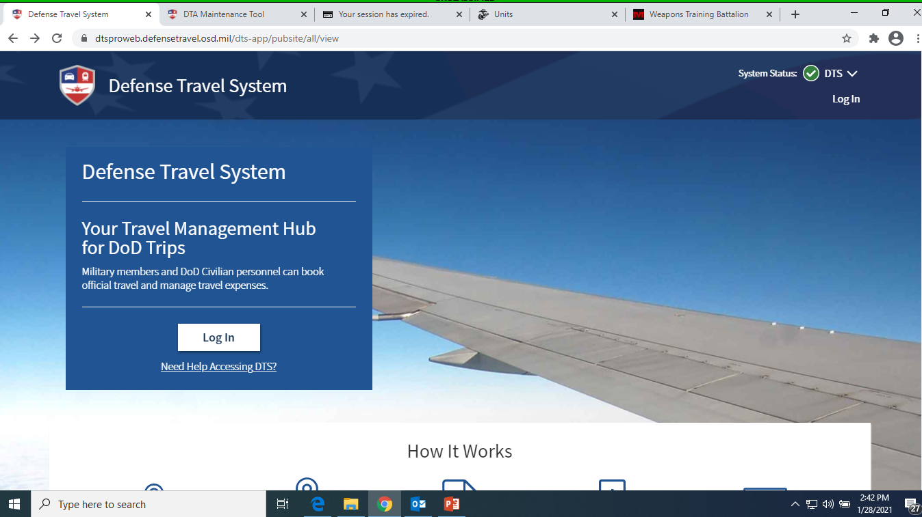
Access DTS website: http://www.defensetravel.osd.mil/

Slide 3
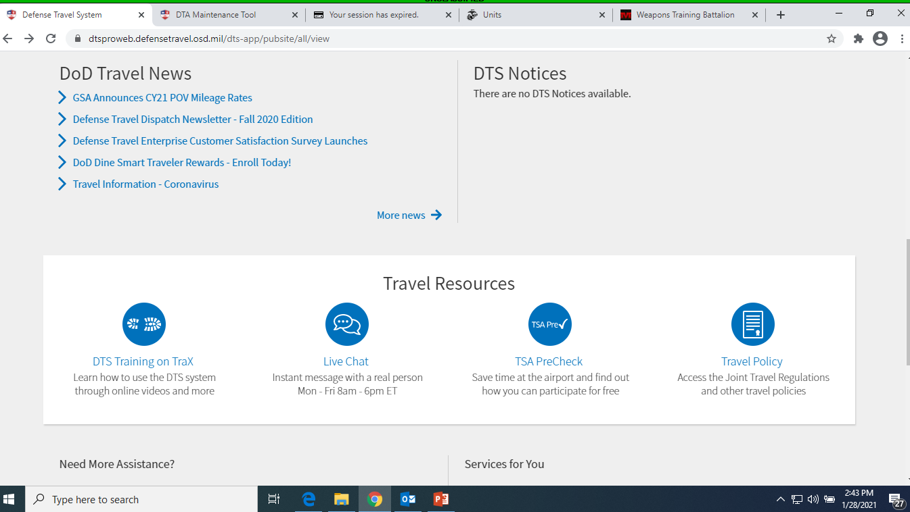
Next: Click the “Trax” link.
SCROLL DOWN
CLICK HERE

Slide 4
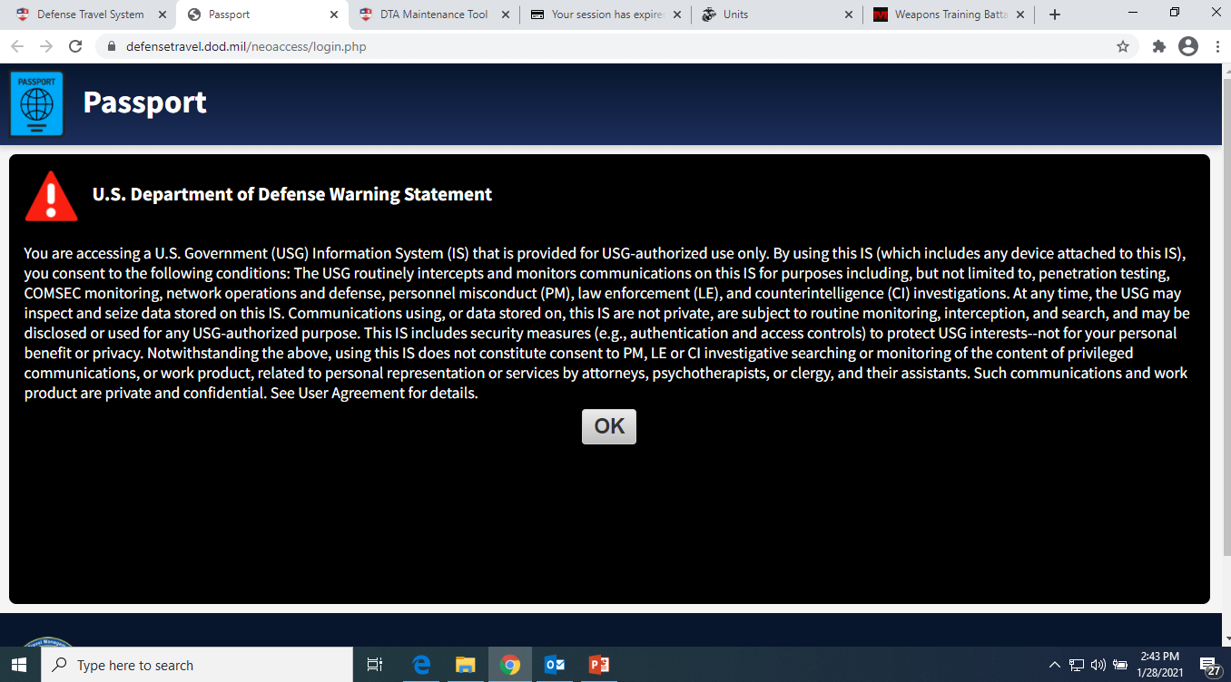
CLICK “OK”

Slide 5
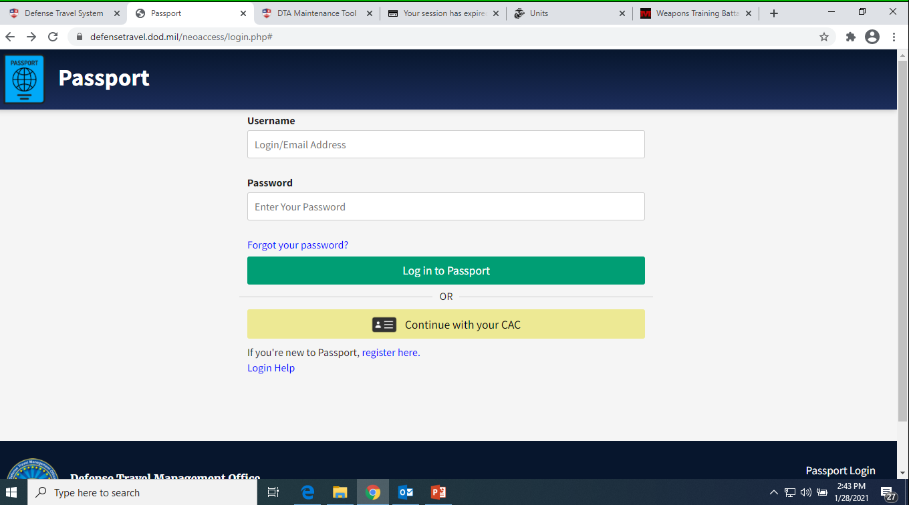
IF YOU ALREADY HAVE AN ACCOUNT, THEN CLICK “CONTINUE WITH YOUR CAC” AND IGNORE THE NEXT SLIDE
CLICK HERE

Slide 6
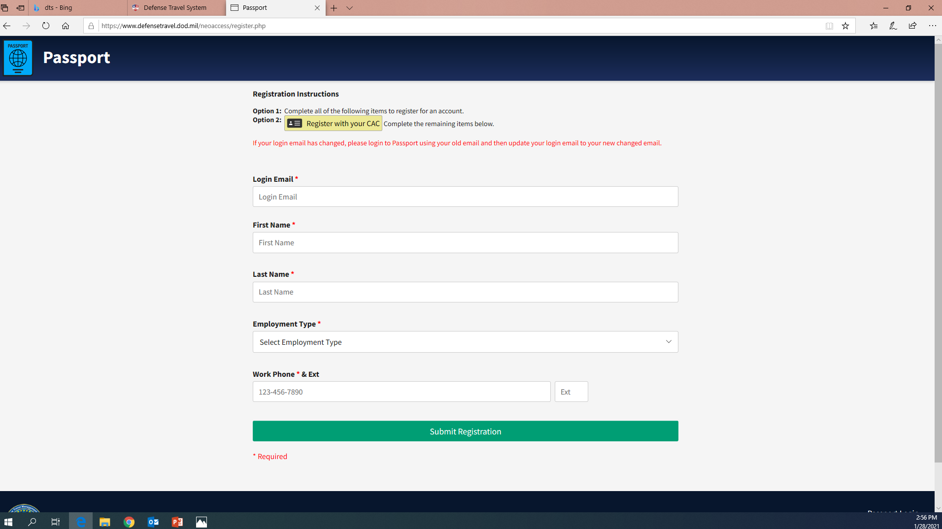
FILL OUT THE REQUIRED INFORMATION
Click submit registration to continue

Slide 7
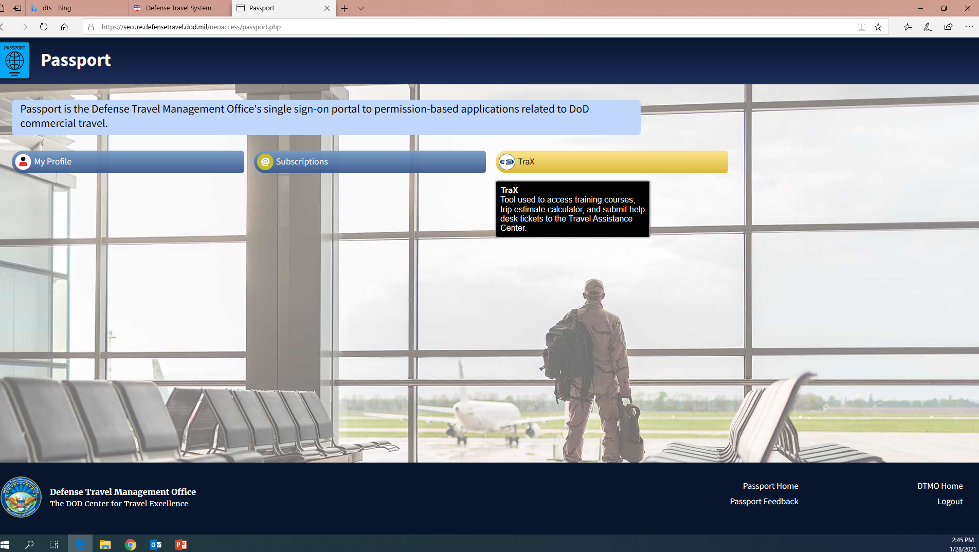
CLICK HERE

Slide 8
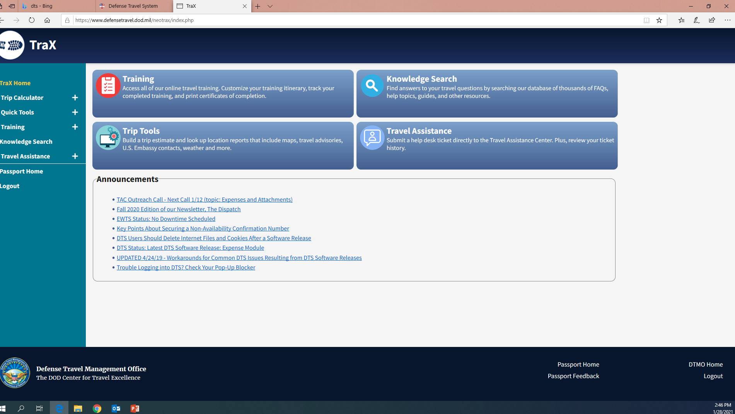
CLICK “TRAINING”

Slide 9
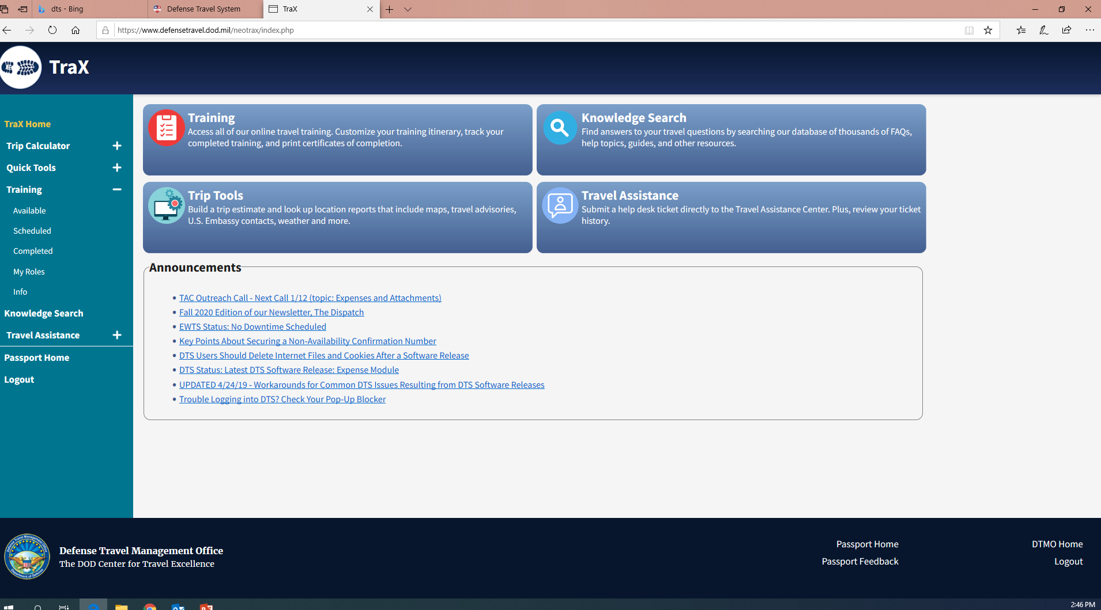
CLICK “AVAILABLE”

Slide 10
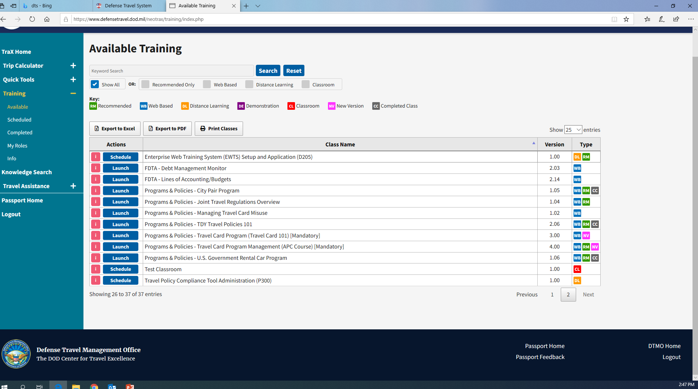
Complete the training below:
Programs and Policies: Travel Card Program (Travel Card 101)[Mandatory]
Click Launch to start the training.

